Slide 1
Lei21_22_s4_2df_03 Progress – Sprint B
Date 01/05/2022
Team
1200625 – Sérgio Lopes 1200628 – Tiago Freitas
1201427 – Nuno Alves 1201428 – Pedro Sousa
1202016 – Vasco Azevedo

Slide 2
Summary
% | % (N-1) | Estado | Data Fim
100% | 100% | ✓ | 01.mai.2022
Project phases
Analysis
Development
Testing

Slide 3
Conclusion of Activities
ID | Atividade | Responsável | Baseline | Real | Estado
G004 | As Project Manager, I want the team to configure the project structure to facilitate / accelerate the development of upcoming user stories. | Tiago Freitas | Início: 10-04-2022 Fim: 01-05-2022 | Início: 10-04-2022 Fim: 01-05-2022 | ✓
1001 | As Sales Clerk, I want to specify a new product for sale. | Sérgio Lopes | Início: 10-04-2022 Fim: 01-05-2022 | Início: 10-04-2022 Fim: 01-05-2022 | ✓
1002 | As Sales Clerk, I want to view/search the products catalog. | Pedro Sousa | Início: 10-04-2022 Fim: 01-05-2022 | Início: 10-04-2022 Fim: 01-05-2022 | ✓
1003 | As Sales Clerk, I want to register a new customer. | Vasco Azevedo | Início: 10-04-2022 Fim: 01-05-2022 | Início: 10-04-2022 Fim: 01-05-2022 | ✓
1004 | As Sales Clerk, I want to create a new products order on behalf of a given customer. | Vasco Azevedo | Início: 10-04-2022 Fim: 01-05-2022 | Início: 10-04-2022 Fim: 01-05-2022 | ✓
1005 | As Sales Clerk, I want to define a new category of products. | Sérgio Lopes | Início: 10-04-2022 Fim: 01-05-2022 | Início: 10-04-2022 Fim: 01-05-2022 | ✓
1900 | bootstrap | Sérgio Lopes | Início: 10-04-2022 Fim: 01-05-2022 | Início: 10-04-2022 Fim: 01-05-2022 | ✓
2001 | set up the warehouse plant by uploading a JSON file | Nuno Alves | Início: 10-04-2022 Fim: 01-05-2022 | Início: 10-04-2022 Fim: 01-05-2022 | ✓
2002 | Configure the AGVs available on the warehouse | Tiago Freitas | Início: 10-04-2022 Fim: 01-05-2022 | Início: 10-04-2022 Fim: 01-05-2022 | ✓
9001 | prepare a presentation | Pedro Sousa | Início: 10-04-2022 Fim: 01-05-2022 | Início: 10-04-2022 Fim: 01-05-2022 | ✓

Slide 4


Objective of the System
The objective of this system is to creat an app similar to various websites well-known such as Amazon, Worten, Fnac and others thousands companies that use a shopping cart and AGV’s to automate the process of making sales online.

Slide 5
Development process and planning
US / Responsible | Nuno Alves | Pedro Sousa | Sérgio Lopes | Tiago Freitas | Vasco Azevedo
G004 |  |  |  | X
1001 |  |  | X
1002 |  | X
1003 |  |  |  |  | X
1004 |  |  |  |  | X
1005 |  |  | X
1900 |  |  | X
2001 | X
2002 |  |  |  | X
9001 |  | X

Slide 6
Teamwork Methodology
The Scrum methodology was the agile methodology that we used because:
Our project is liable to change.
We are not sure at the outset what the solution will look like.
Our client needs to be involved at every stage.

Slide 7
Conflict Resolution Strategy
We worked acording to these 5 rules of Conflict Resolution:
Don’t ignore conflict
Clarify what the issue is
Bring involved parties together to talk
Identify a solution
Continue to monitor and follow up on the conflict

Slide 8
Product Quality
 | Code Coverage
Project | %

Slide 9
Expected Results
In our expected results we expect nothing less than all User Stories finished with sucess, therefore we will work hard and apply what we were taught to achieve that.

Slide 10
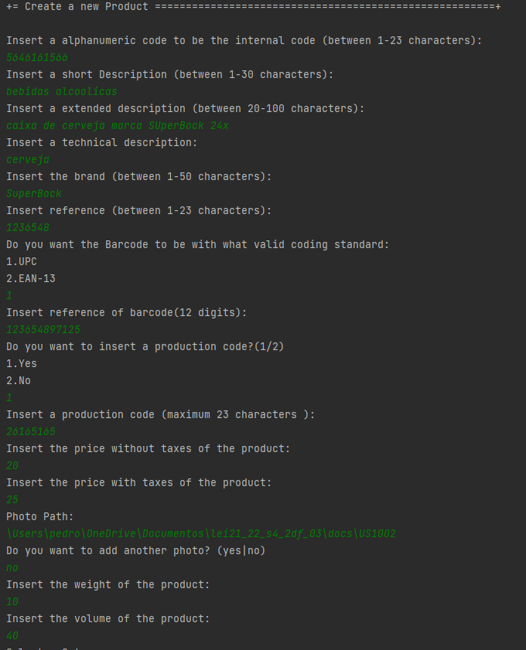
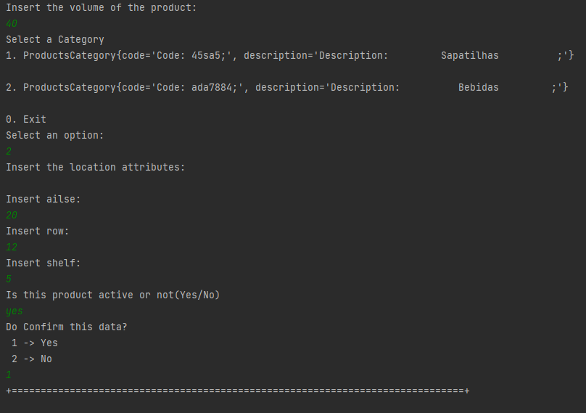
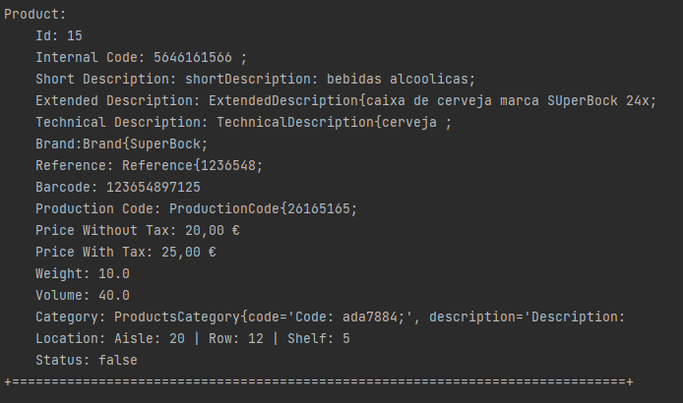
Software delivery – US1001

Slide 11
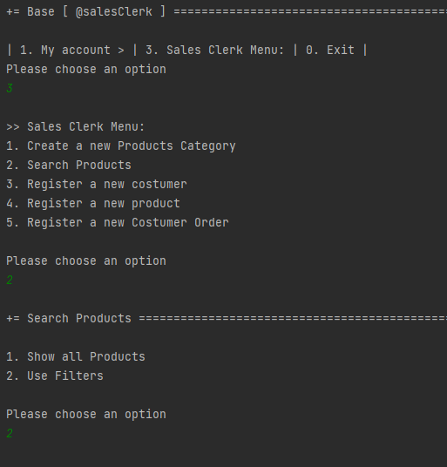
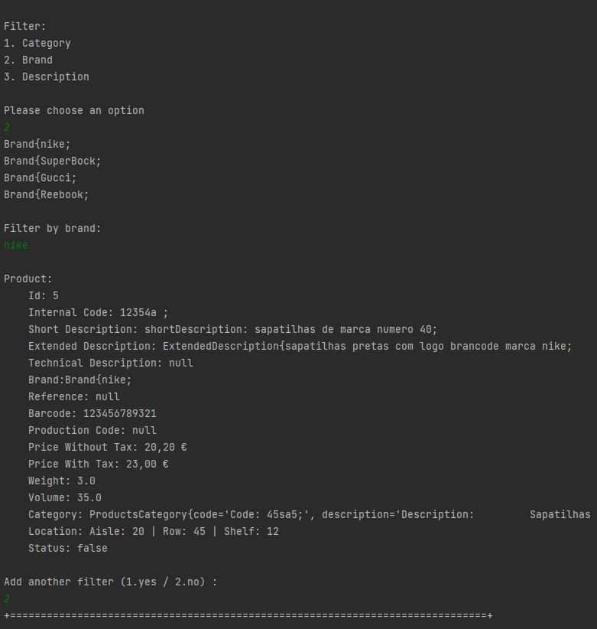
Software delivery – US1002

Slide 12
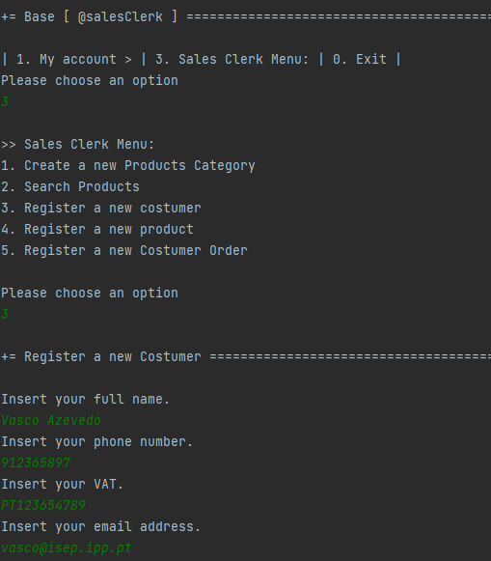
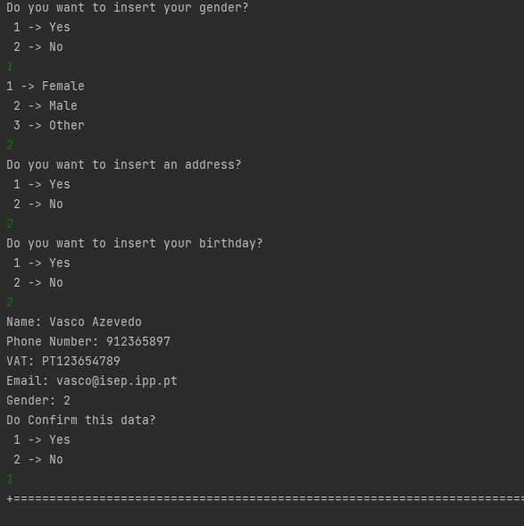
Software delivery – US1003

Slide 13
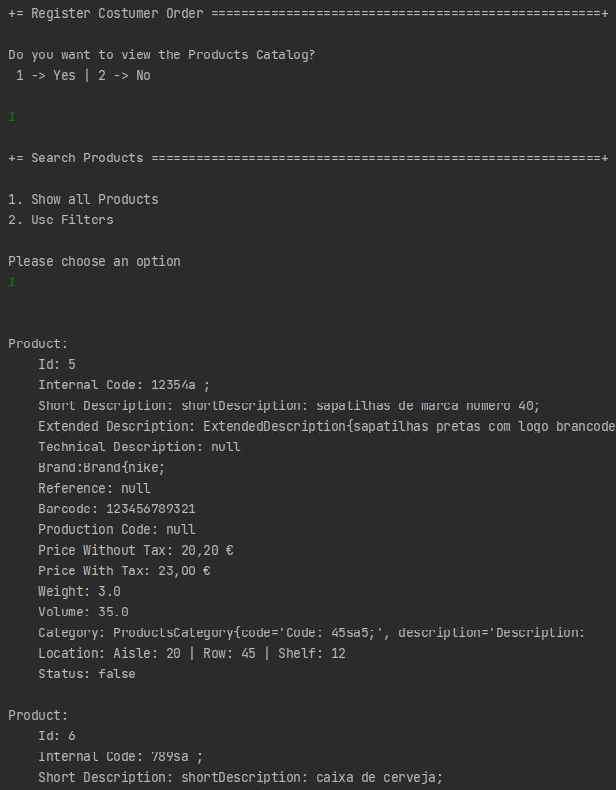
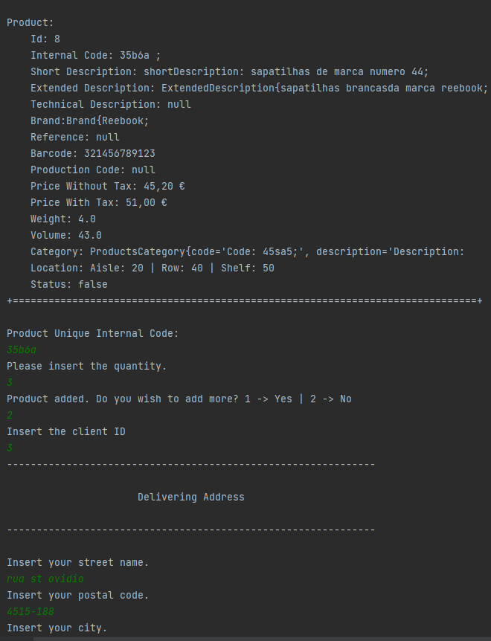
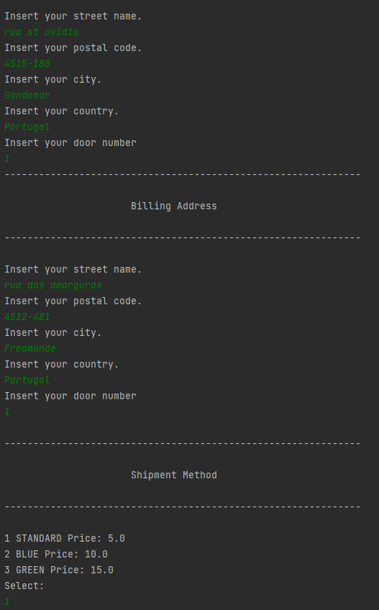
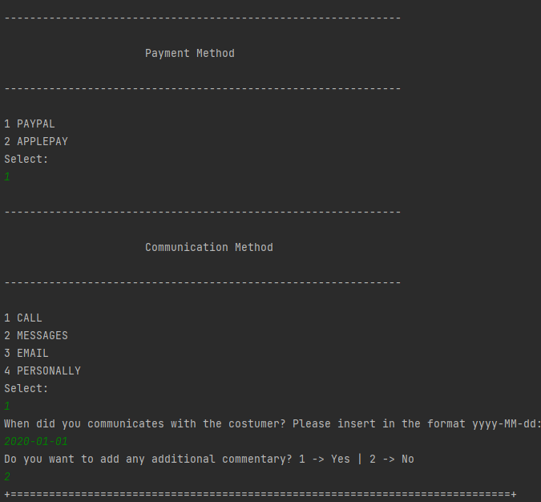
Software delivery – US1004

Slide 14
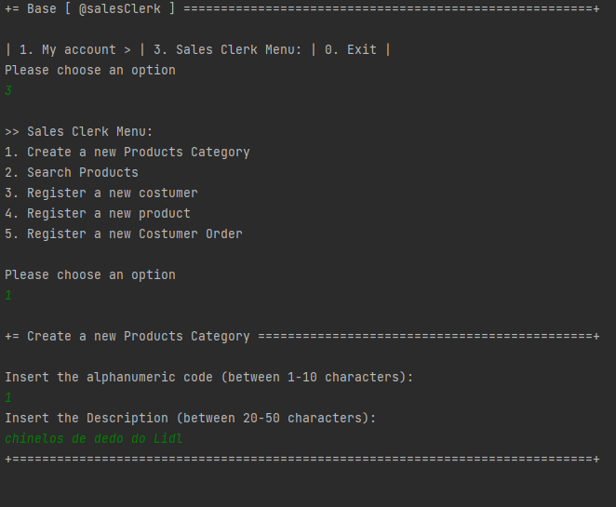
Software delivery – US1005

Slide 15
Lei21_22_s4_2df_03 Progresso – Sprint b
Data 01/05/2022

